Slide 1
Detection of Artificial Intelligence Generated Images
Riski Adianto
Saira Faiz
Colby Jamieson
Karl Yazigi

Slide 2
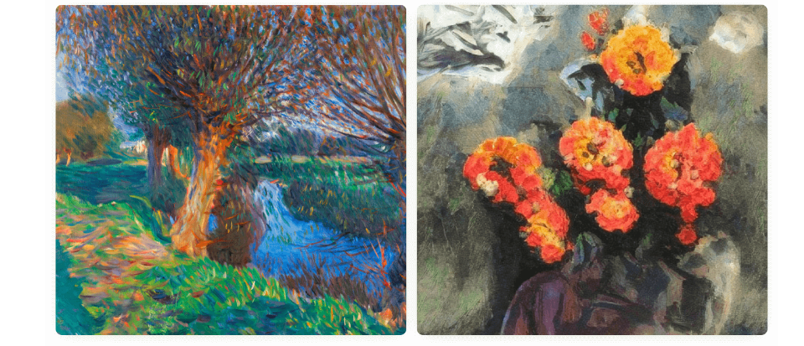
Introduction
What do you think?
Which one is a real painting and which is AI-generated.
A
B
A is a real painting and B is AI-generated.
B is a real painting and A is AI-generated.

Slide 3
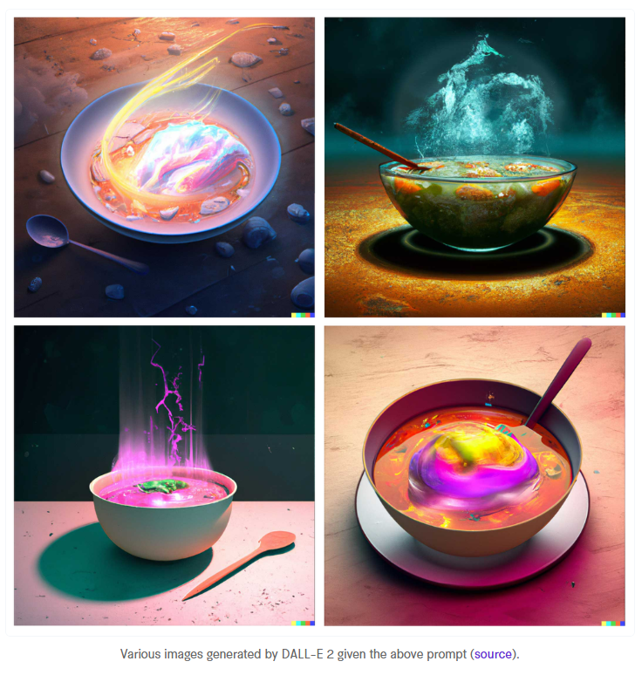
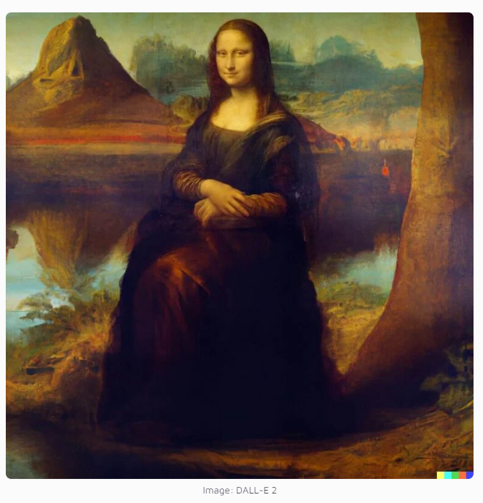
Introduction
"a bowl of soup that is a portal to another dimension as digital art".
What are the capabilities of DALL-E
DALL-E 2 can create photorealistic images based on prompts and textual description.
DALL-E 2 can modify or extend existing images.
Edits features such as hairstyle, nose, face, gender.
Create background based on textual description.

Slide 4
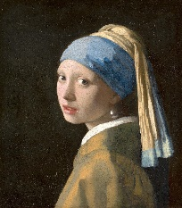
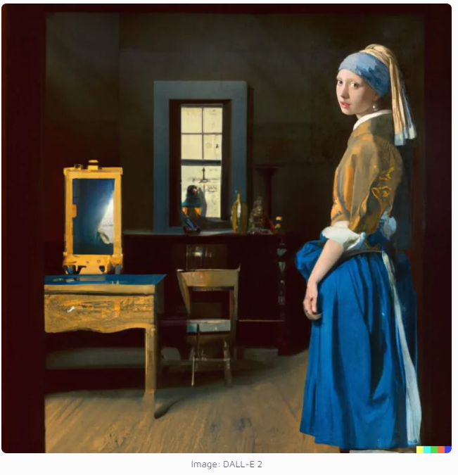
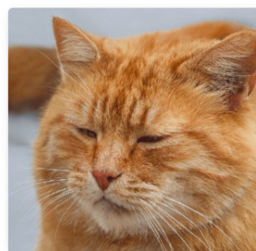
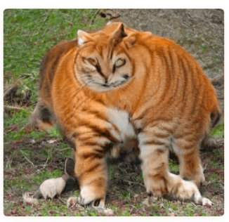
Introduction
Shortcomings of AL generated images
It’s still difficult to draw certain parts of the body, like hands.
It can mix different images.

Slide 5
Objective & Scope
Whether the model can detect, if the image is AI generated.
Automated identity verification, forensics. Deepfake technology.
Improve the capabilities of AI
By developing algorithms that can distinguish between images generated by machines and those captured by humans.
Robotics, autonomous vehicles, and surveillance systems.

Slide 6
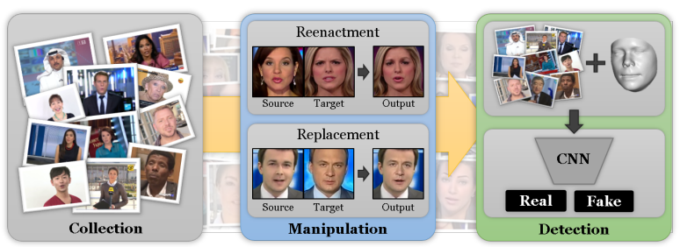
Related Work
Much work has been done on detection of deepfake videos. Where facial expressions are manipulated or facial identity is being manipulated.
FaceForensics++: Learning to Detect Manipulated Facial Images
DETECTING IMAGE SPLICING IN THE WILD (WEB)

Slide 7
Methodology
Probably include Theory/Background on Convolutional neural networks as well as how dall-e works:
Sub-sentence

Slide 8
Data Collection
Dall-e images were scraped from the website: 'https://dalle2.gallery/#search-random’:
Human made images were scraped from google using different search keywords, you can find the keywords used for this in the data scrape.ipynb file saved as a list “categories”.
Images are various styles of art (cartoon, oil painting, digital art, anime etc) and photorealistic images (humans, animals, outdoors etc) for both Dall-e and human made images
Images were left in RGB format as an array. So an array of shape(255,245,3). Values were scaled to bebetween 0->1
Sub-sentence

Slide 9
Data Collection
Images were processed to be of shape 255x245 pixels, this crops out the bottom of dall-e pictures removing the watermark to avoid fitting to this watermark
Sub-sentence

Slide 10
Model Details
Used a convolutional network for the model. Shape and size of the neural network can be found on the train-results.ipynb file:
Sub-sentence

Slide 11
Training
Model was trained for 10 epochs on 5 batches of 1800 images. So a total of 9000 images were used to train the model split equally between DALL-E generated and Human made images:
Sub-sentence

Slide 12
Testing
Test batch was 1580 images 930 of which were dall-e generated and 650 human made:
Sub-sentence

Slide 13
Results
The 50 epochs on the graph for accuracy are because of the 10 epochs for 5 batches (10x5 = 50):
I’ve made graphs of accuracy, confusion matrix (for fp tp fn and tn rates), and the ROC and AUC curve
Sub-sentence

Slide 14
Discussion
Sentence:
Sub-sentence

Slide 15
Summary
Sentence:
Sub-sentence

Slide 16

Thank You

